Slide 1
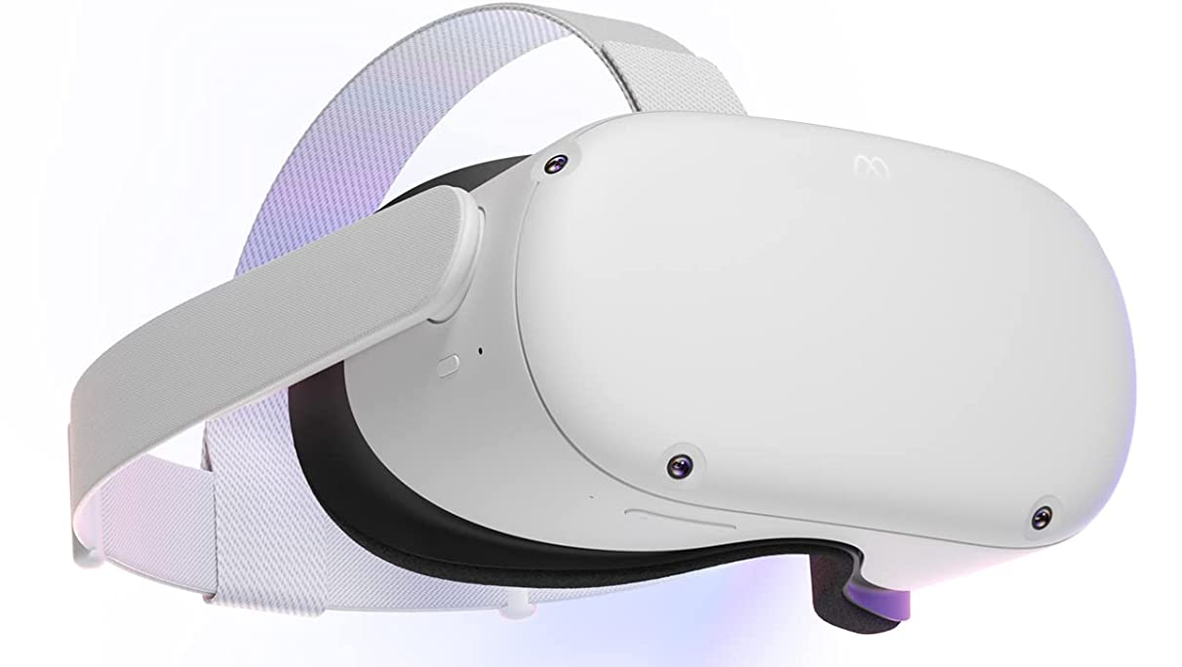
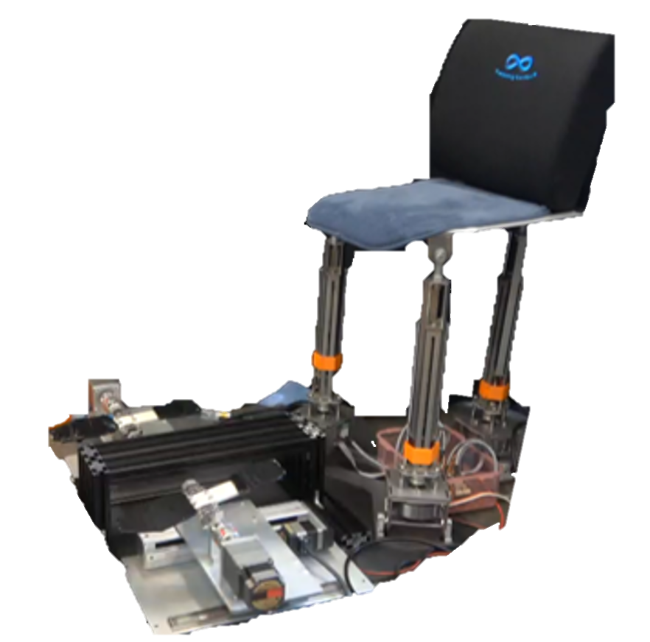
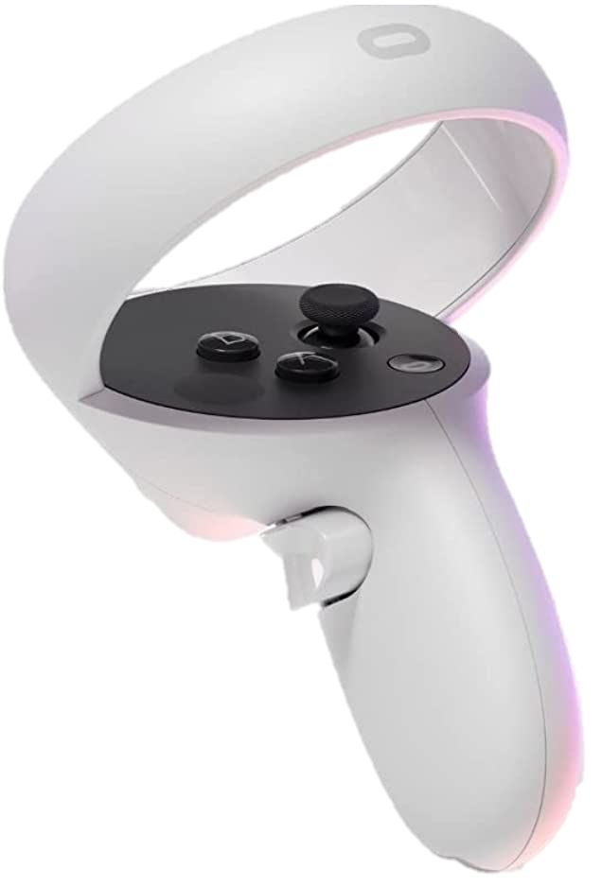

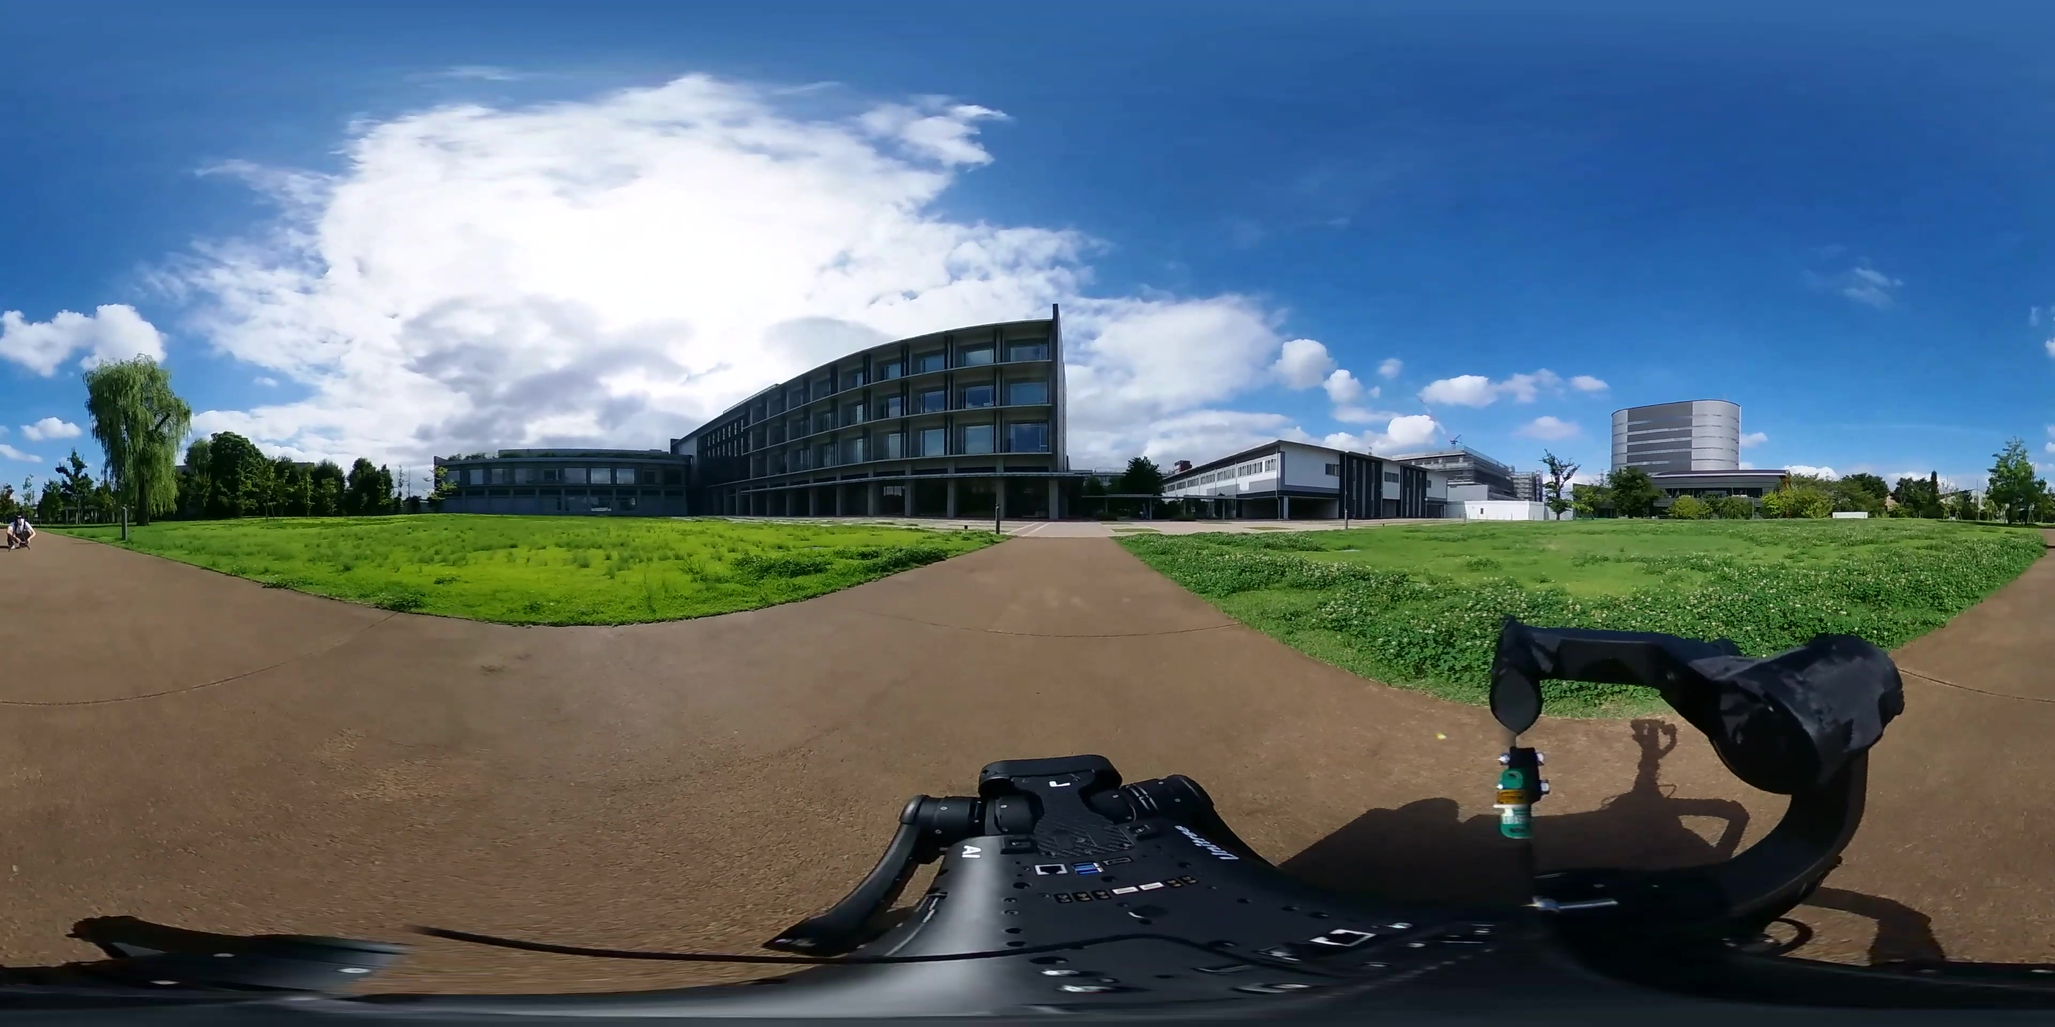
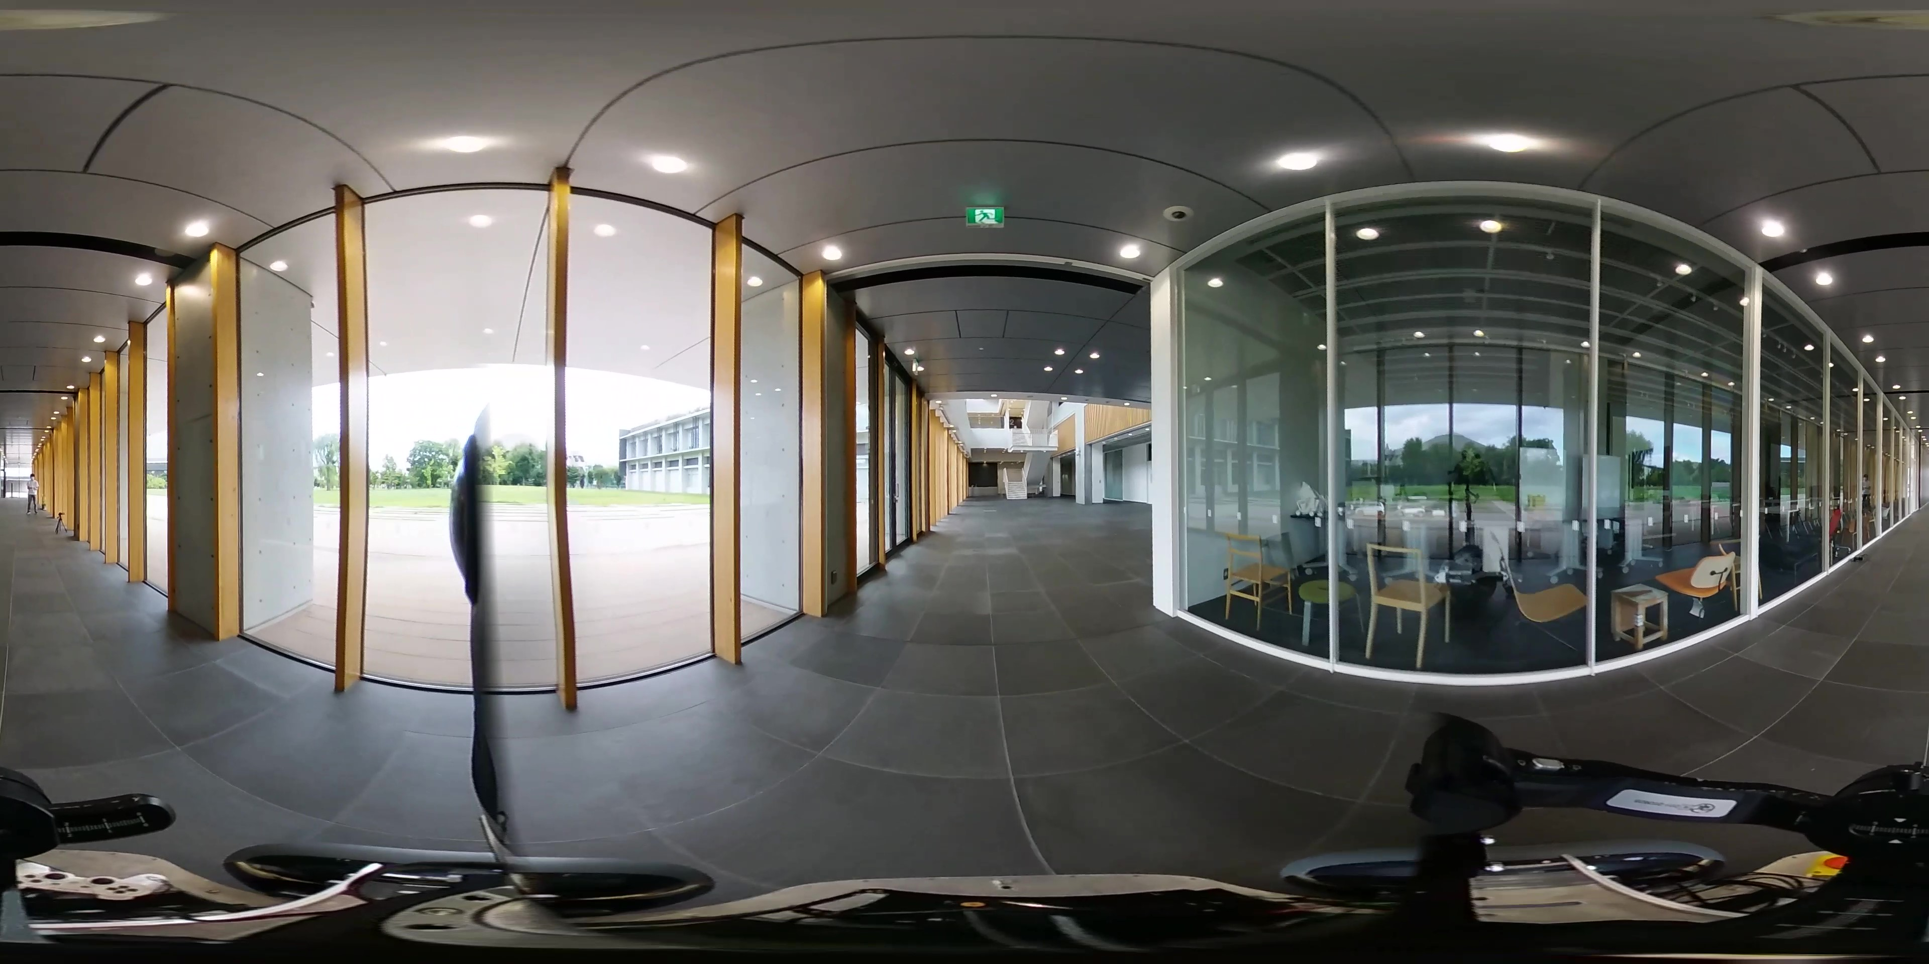

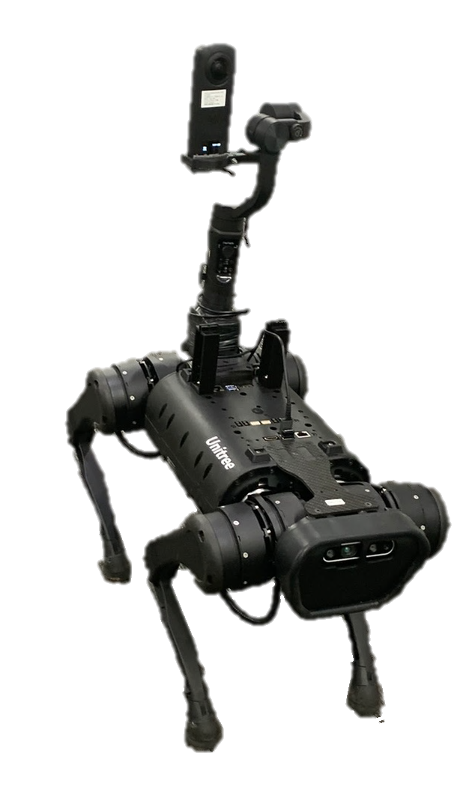
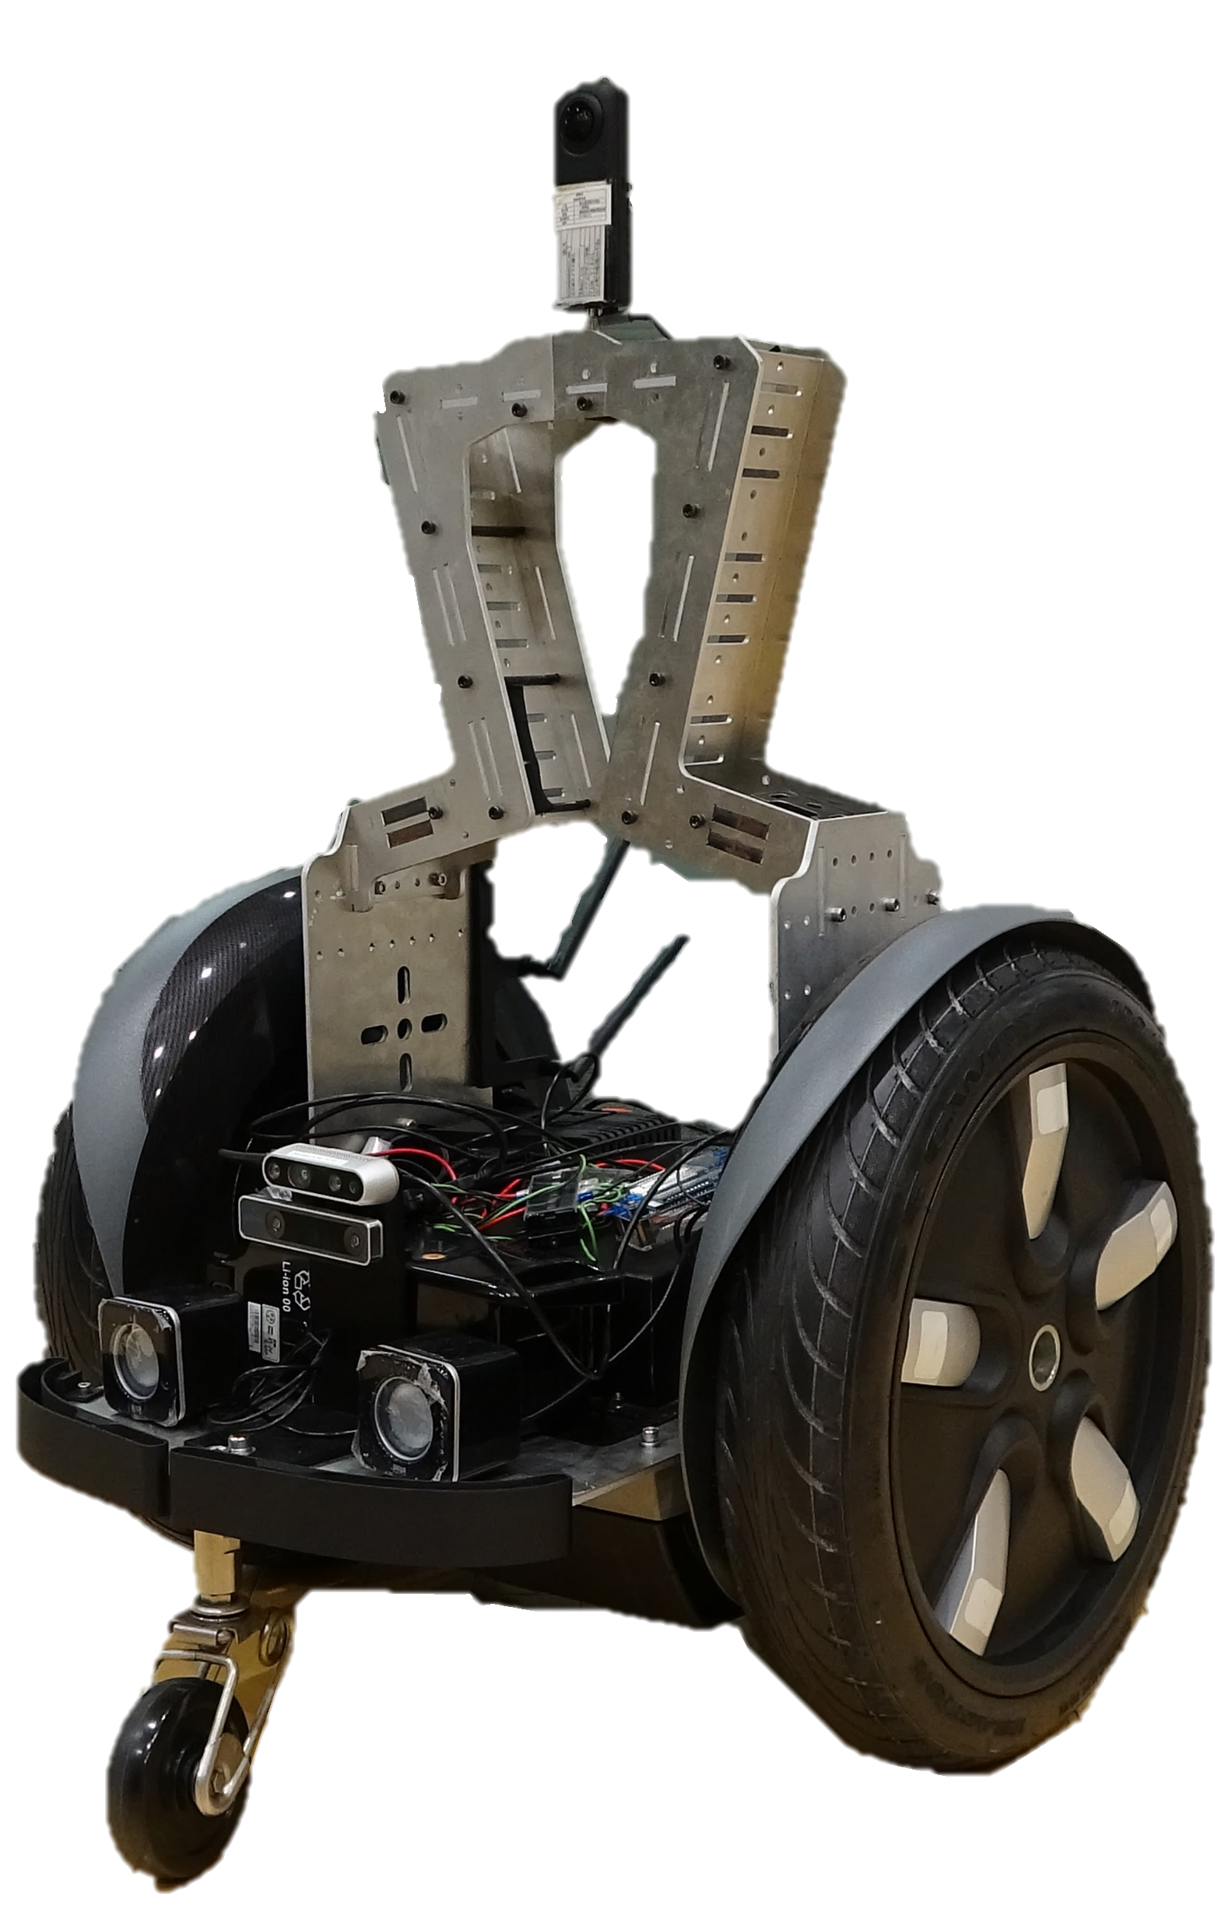

Meta Quest2
Web XR input device
Angle of joystick
Meta Browser
Walking Display
Controller
EPOS4, ESP32
Real time 3D engine
using a JavaScript library
PC
WebRTC SDK
(Sora Unity SDK)
WebRTC SDK
(Sora JavaScript SDK)
SFU Server (Sora, Ubuntu)
Status of robots
$360$° Video
4K 30FPS H.264
Quadruped robot
Wheeled robot
360°4K Camera
(THETA Z1)
360°4K Camera
(THETA Z1)
Sensor PC
(Jetson NX)
Sensor PC
(Jetson NX)
Leg Controller Board
Wheel Controller Board

